Slide 1



Competitor analysis
View in Power BI
Last data refresh:
13/07/2023 07:36:43 UTC
Downloaded at:
13/07/2023 14:01:32 UTC

Slide 2
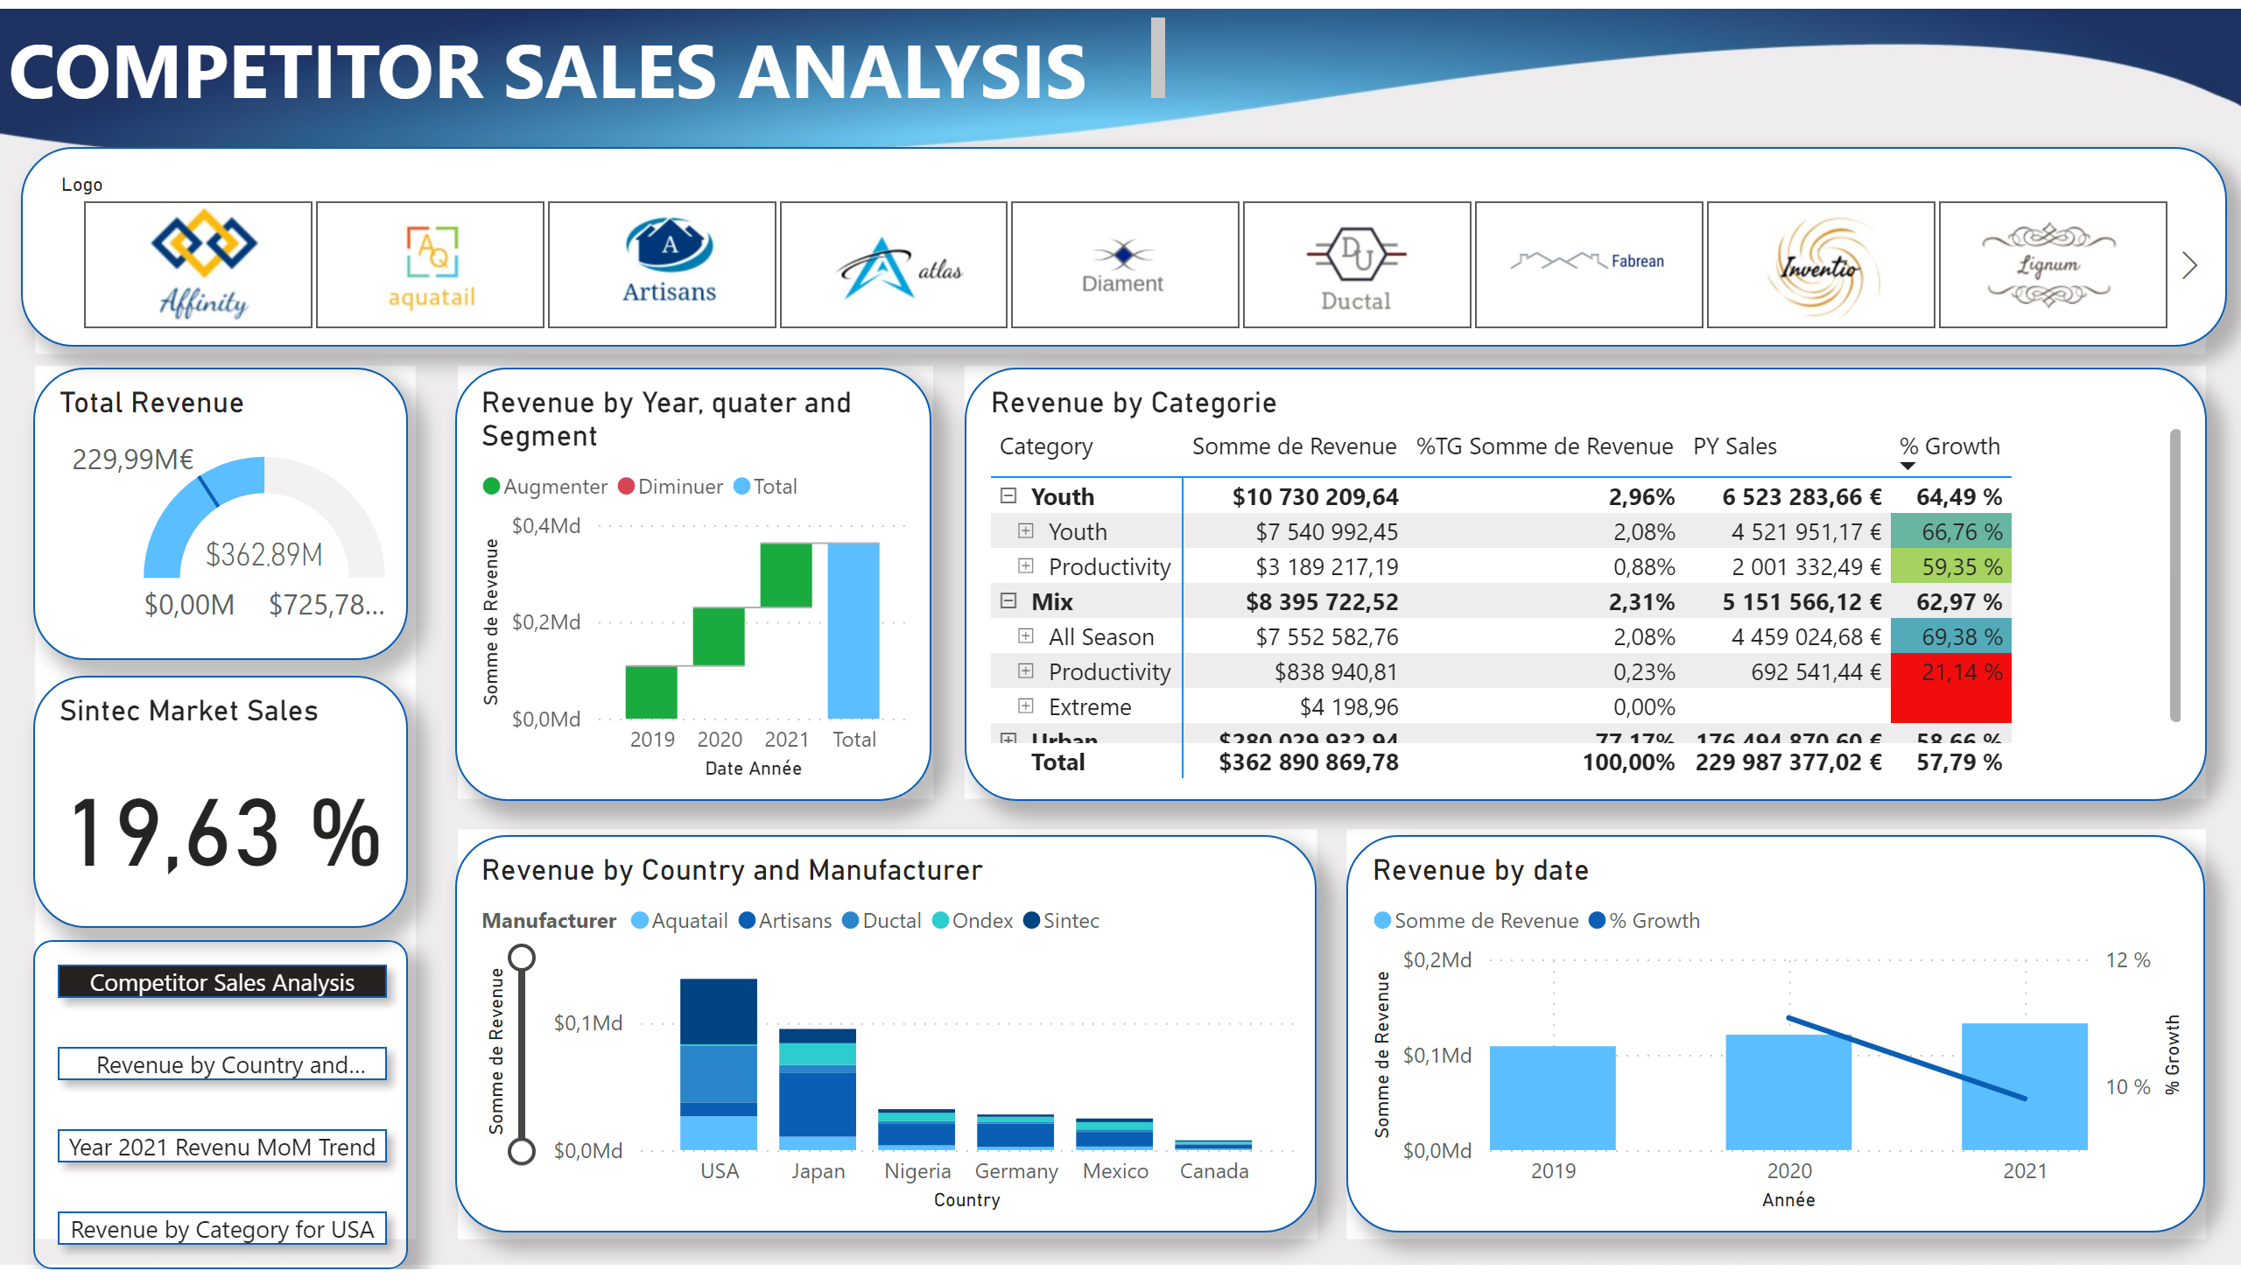
Competitor Sales Analysis
Notes:
Revenue by Country and Manufacturer
No alt text provided
Total Revenue
No alt text provided
Revenue by date
No alt text provided
Logo
No alt text provided
Revenue by Year, quater and Segment
No alt text provided
Revenue by Categorie
No alt text provided
Sintec Market Sales
No alt text provided
textbox
No alt text provided
bookmarkNavigator
No alt text provided

Slide 3
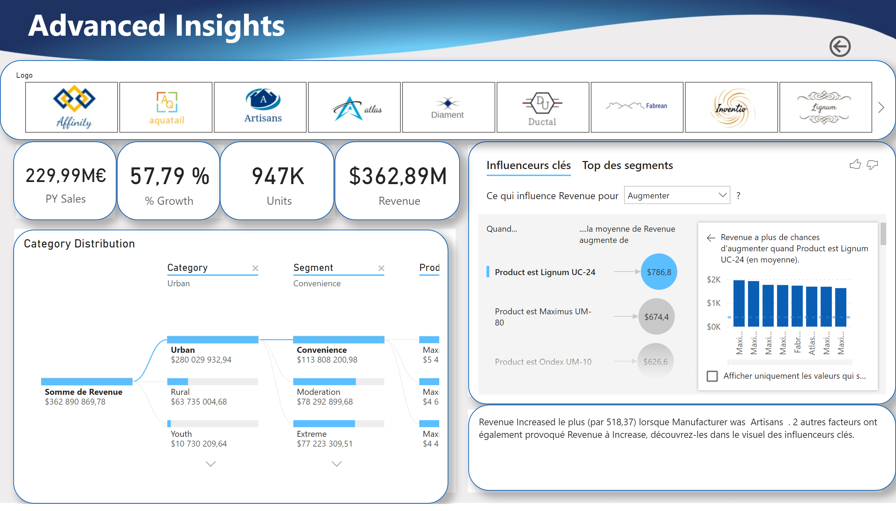
Advanced Insights
Notes:
Category Distribution
No alt text provided
keyDriversVisual
No alt text provided
slicer
No alt text provided
textbox
No alt text provided
card
No alt text provided
card
No alt text provided
card
No alt text provided
card
No alt text provided
actionButton
No alt text provided
textbox
No alt text provided

